Slide 1
Mensuration

Slide 2
Mensuration is the branch of mathematics which deals with the study of Geometric shapes, their area, volume and related parameters.
Learning Outcomes
Through this Topic Candidates should be able to
understand the basic concepts of mensuration
observe the data given and interpret it from the given problem
apply the Concepts to solve Company Specific Aptitude tests
apply the Concepts to solve questions asked in various government exams like SSC CGL, Banking Sector etc.

Slide 3
Contents
2D Figures: Area, Perimeter.
3D Figures: Volume, Curved surface Area and Total surface Area.
2D Figures | 3D Figures
Rectangle | Cuboid
Square | Cube
Triangle | Cylinder
Circle | Cone
Parallelogram | Sphere
Trapezium | Hemisphere

Slide 4
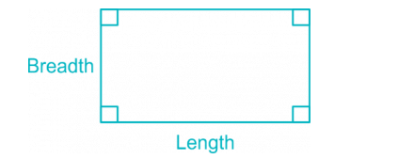
2D Figures:
Rectangle
Area of Rectangle = Length × Breadth.
Perimeter of a Rectangle = 2 × (Length + Breadth)
Length of the Diagonal = √(Length² + Breadth² )

Slide 5
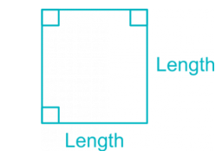
Square
Area of a Square = Length × Length = (Length)²
Perimeter of a square = 4 × Length
Length of the Diagonal = √(2) × Length

Slide 6
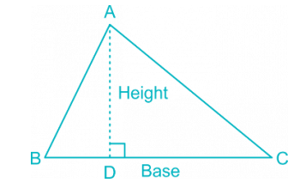

Triangle

Slide 7
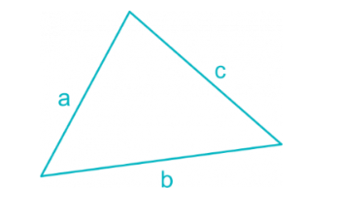
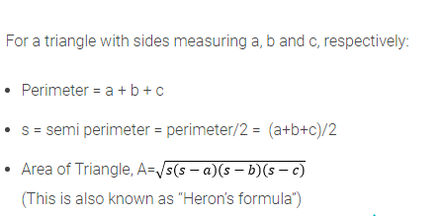
Triangle

Slide 8
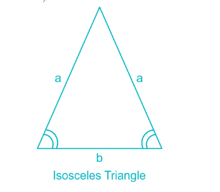

Isosceles Triangle
Area of Isosceles Triangle:
(Where a = length of two equal side, b = length of base of isosceles triangle.)

Slide 9
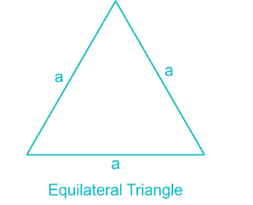

Equilateral Triangle
Area of Equilateral Triangle

Slide 10
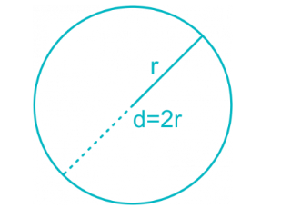
Circle & Semicircle
Area of a circle = πr² = 𝜋d²/4
Circumference of a circle = 2πr = πd
Circumference of a semicircle = πr + 2r
Area of semicircle = 𝜋r²/2
(In the following formulae, r = radius and d = diameter of the circle)

Slide 11
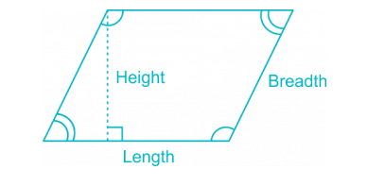
Parallelogram
Area of a Parallelogram = Length × Height
Perimeter of a Parallelogram = 2 × (Length + Breadth)

Slide 12
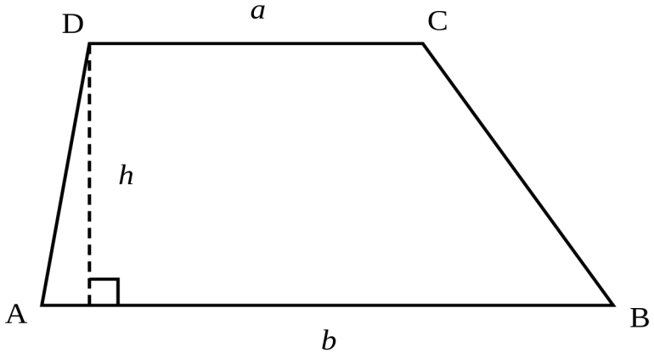
Trapezium
Area of a trapezium =(1/2)× sum of parallel sides × distance between parallel sides

Slide 13
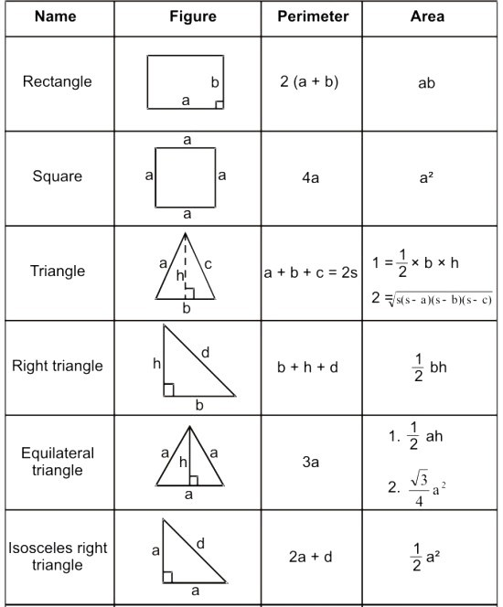

Slide 14
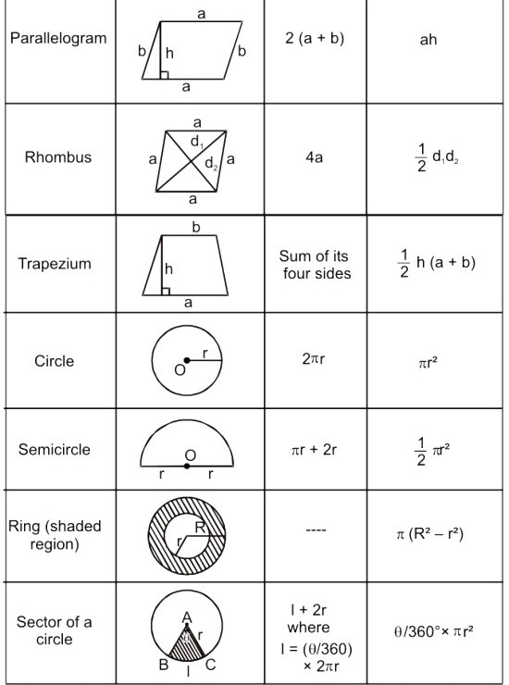

Slide 15
Practice Questions

Slide 16
The area of a square is 4096 sq. cm. Find the ratio of the breadth and length of a rectangle whose length is twice the side of the square and breadth is 24 cm less than the side of the square
5:32
7:16
5:16
None of these
Ans. C

Slide 17
2. A wire in the form of a circle of radius 3.5 m is bent in the form of a rectangle whose length and breadth in the ratio of 6:5. What is the area of rectangle.
30
60
120
None of these
Ans. A

Slide 18
3. The circumference of two circles are 264 m and 352 m. Find the difference between area of the larger and smaller circles.
4123
8642
4312
2612
Ans. C

Slide 19
4. What would be the cost of building 7 m wide garden around a circular field with diameter equal to 280m, if the cost per sq. m for building the garden is Rs. 21
Rs. 156242
Rs. 248521
Rs. 132594
None of these
Ans. C

Slide 20
5. A cow is tied on the corner of a rectangular field of size 30m*20m by a 14 m long rope. The area of the region that she can graze is
350 sq. m
196 sq. m
154 sq. m
22 sq. m
Ans. C

Slide 21
6. At each corner of a triangular field of side 26m, 28m and 30m a cow is tethered by a rope of length 7m. The area un-grazed by the cow is
336 sq. m
259 sq. m
154 sq. m
77 sq. m
Ans. B

Slide 22
7. The radius of a circular field is equal to the side of a square field. If the difference between the perimeter of the circular field and that of the square field is 32m, what is the perimeter of the square field?
84m
95m
56m
28m
Ans. C

Slide 23
8. Two equal maximum sized circular plates are cut-off from a circular paper-sheet of circumference 352 cm. The circumference of each circular plate is.
176 cm
180 cm
165 cm
150 cm
Ans. A

Slide 24
9. A wire, when bent in the form of a square, encloses a region having area 121 cm2. If the same wire is bent into the form of a circle, then the area of the circle is?
144 sq. cm
180 sq. cm
154 sq. cm
176 sq. cm
Ans. C

Slide 25
10. Four circles having equal radii are drawn with centres at the four corners of a square. Each circle touches the other two adjacent circle. If remaining area of the square is 168 cm square, what is the size of the radius of the circle?
A. 1.4 cm
B. 14 cm
C. 35 cm
D. 21 cm
Ans. B

Slide 26
11. The area of a triangle is 216 cm² and its sides are in the ratio 3 : 4 : 5. The perimeter of the triangle is
6 cm
12 cm
36 cm
72 cm
Ans. D

Slide 27


